Slide 1

How much Git can we learn?
Sarah Lean
@Techielass

Slide 2

Sarah Lean
Cloud Solution Architect at Microsoft
International Speaker, Blogger, YouTuber, Community Leader.
Gardener, cyclist, farmer at heart.

Slide 3

Git is an Open-Source Distributed Version Control System.

Slide 4
Git features
Free and open-source
Supports collaboration
Tracks history
Branching
Lightweight

Slide 5

Install Git
Download the Command Line tool (CLI)
Use a package manager
Graphical User Interfaces (GUI) available

Slide 6
Agenda:
Learn Git commands.

Slide 7
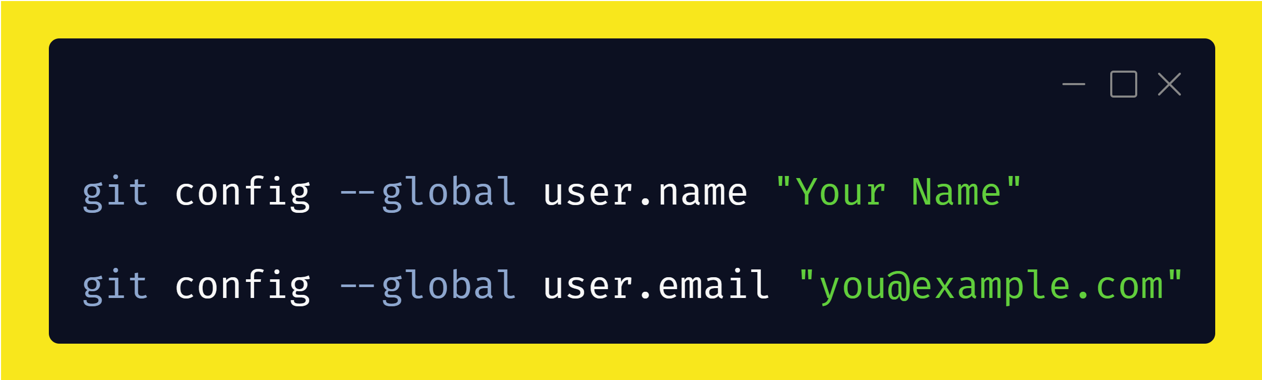
Configure Git

Slide 8
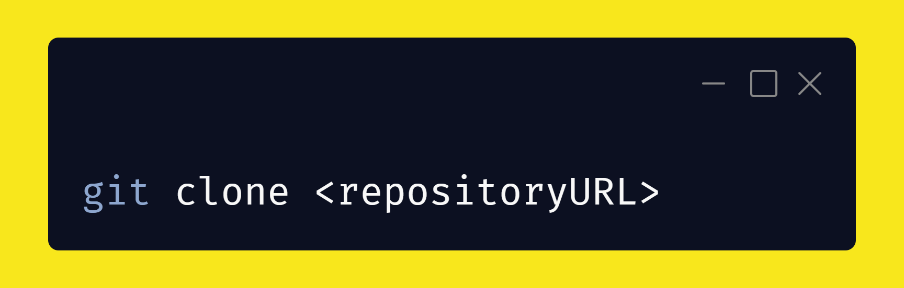
Clone a repository

Slide 9
Clone a repository

Slide 10
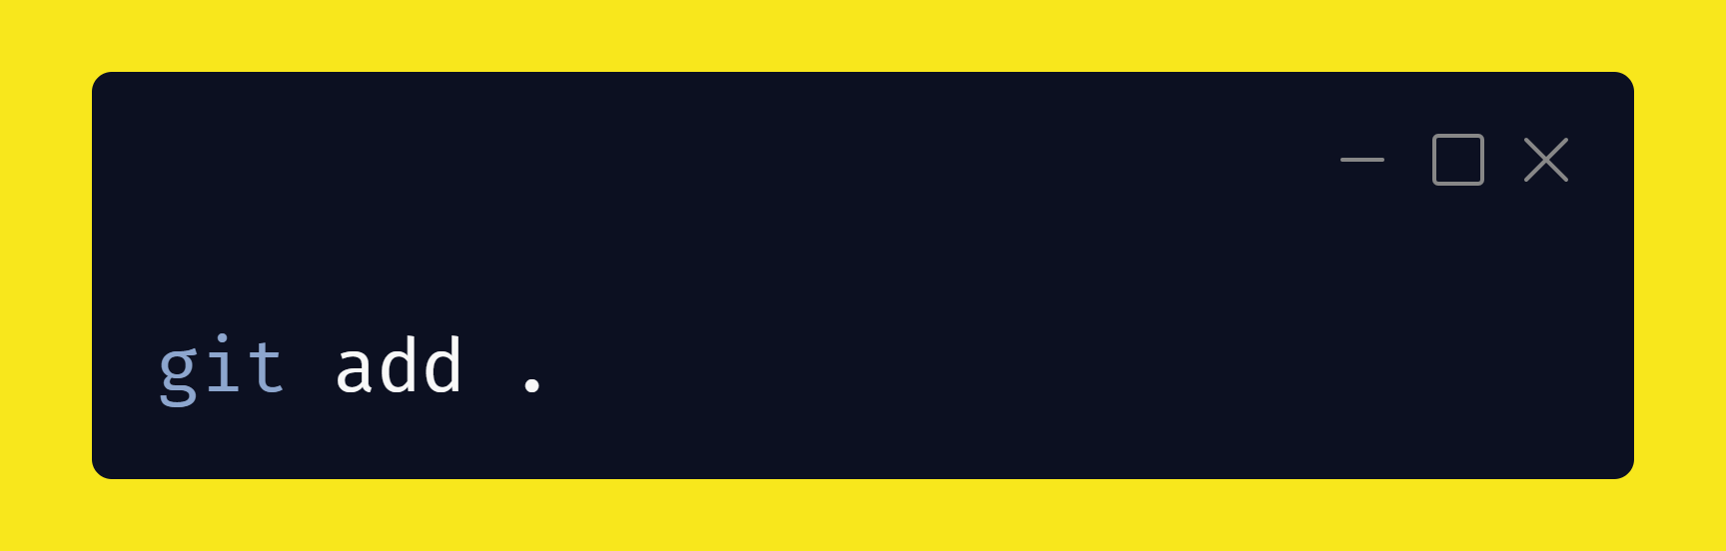
Add files

Slide 11
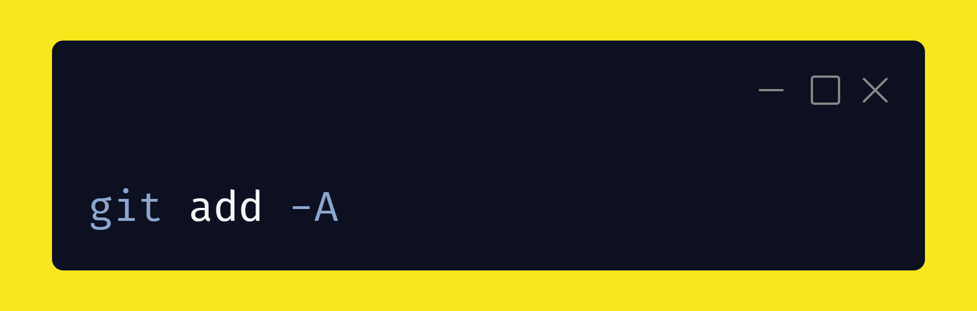
Add files

Slide 12

Add files

Slide 13
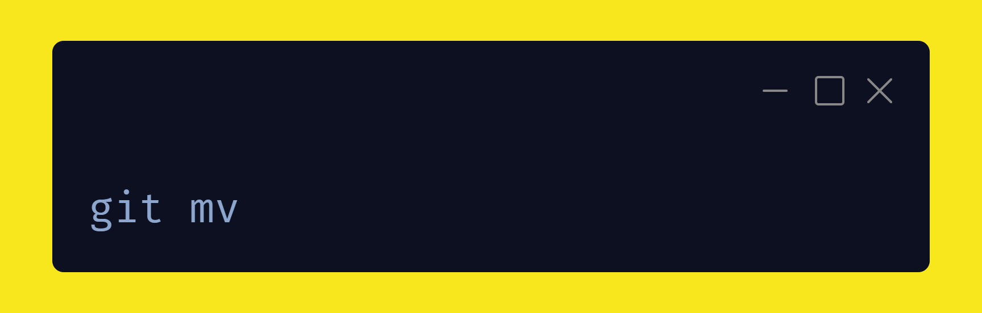
Rename files

Slide 14
Git mv...
Mv old_file.md new_file.md
Git add new_file.add
Git rm old_file.ad

Slide 15
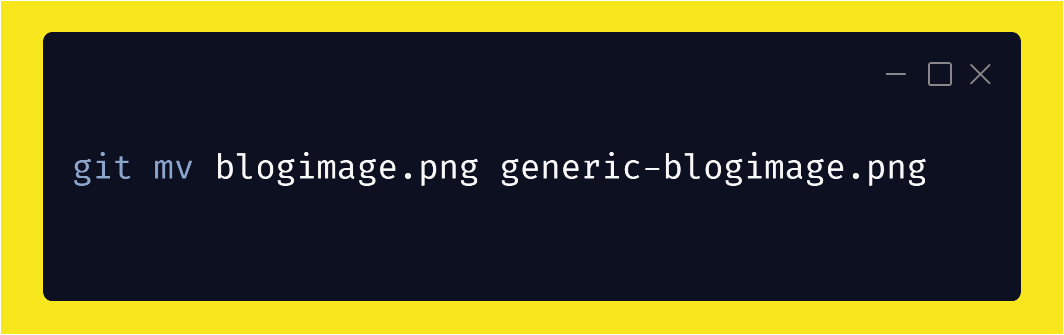
Rename file example

Slide 16
Moving files

Slide 17
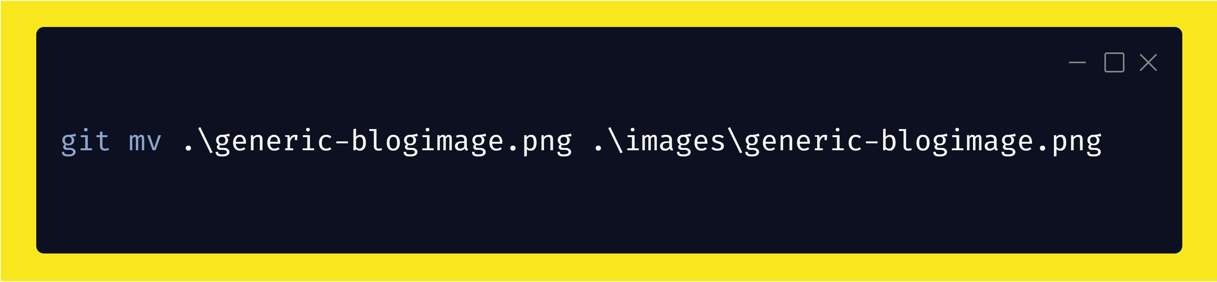
Move file example

Slide 18
Git mv options
Git mv –f
Git mv –k
Git mv –n
Git mv -v

Slide 19
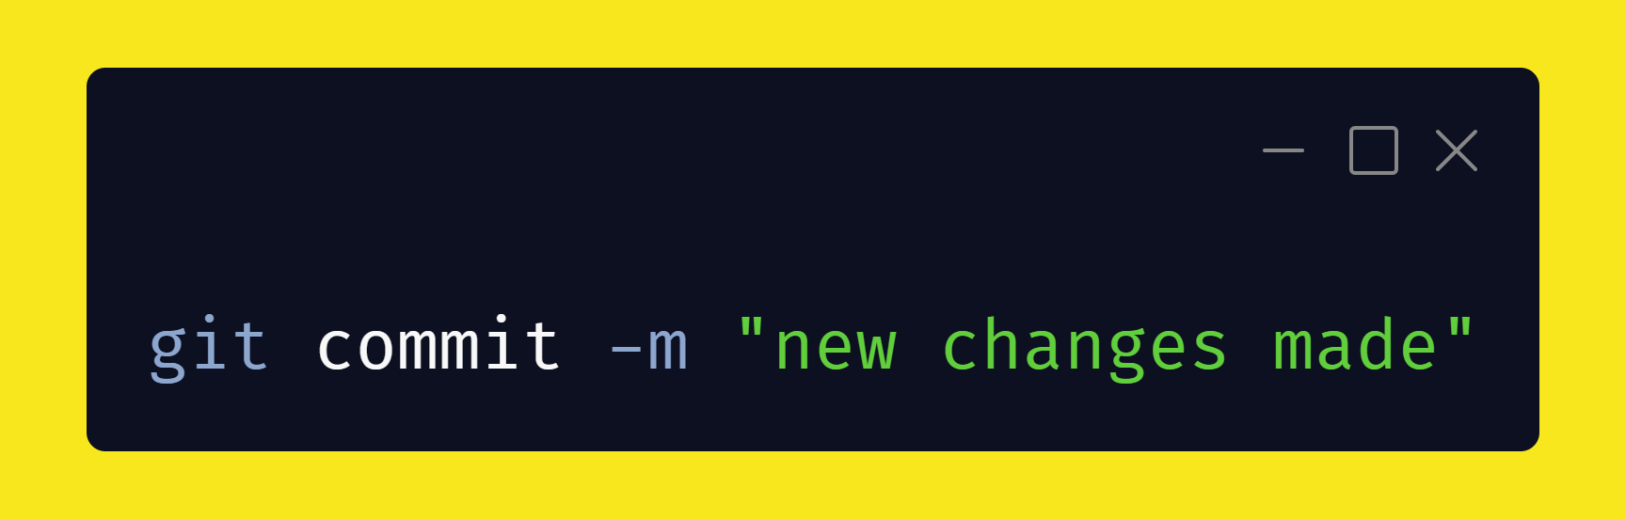
Commit changes

Slide 20
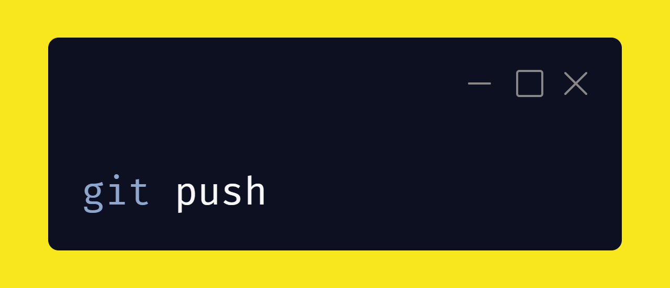
Push changes

Slide 21
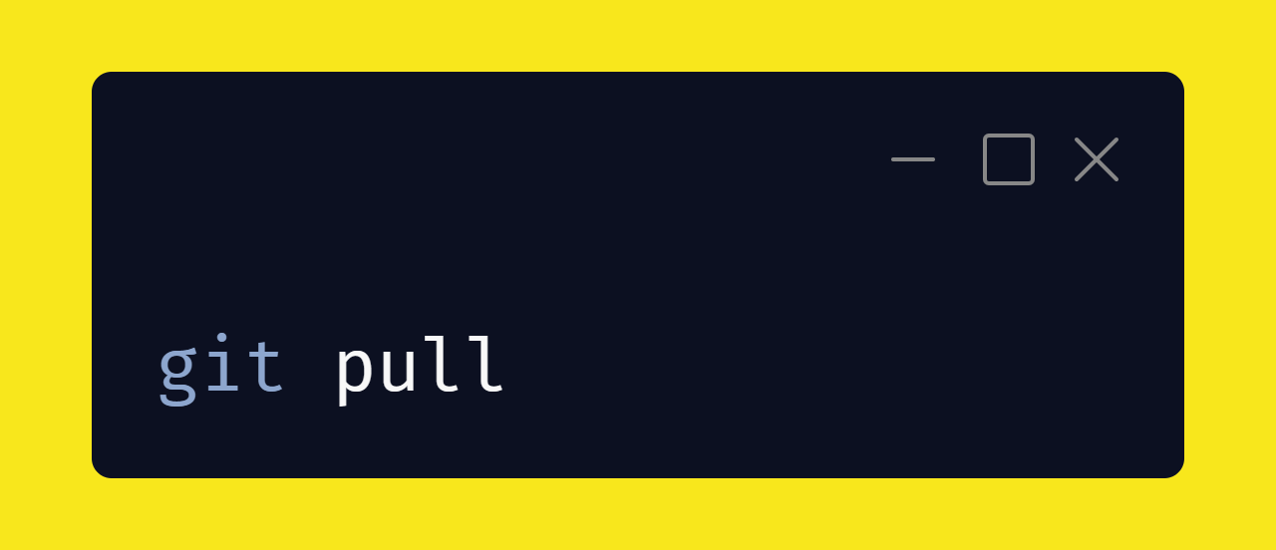
Fetch changes

Slide 22
Git branches are a way of encapsulating your changes for a feature or bug.

Slide 23
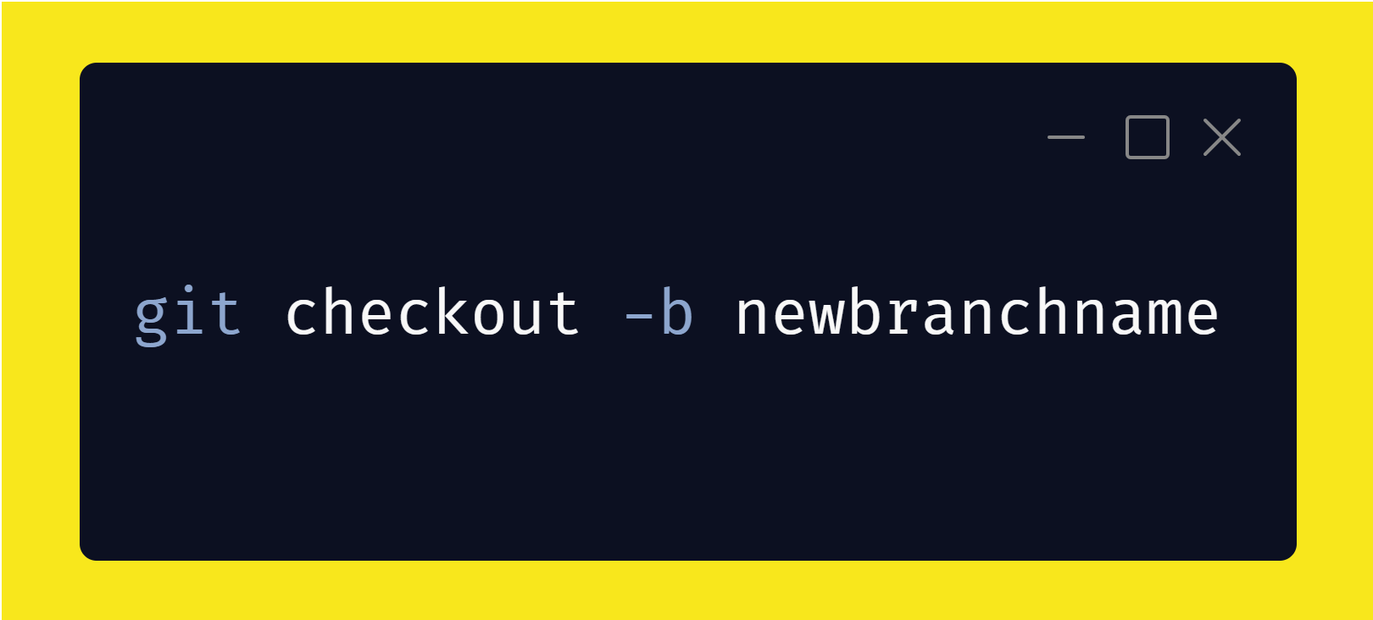
Create a branch

Slide 24
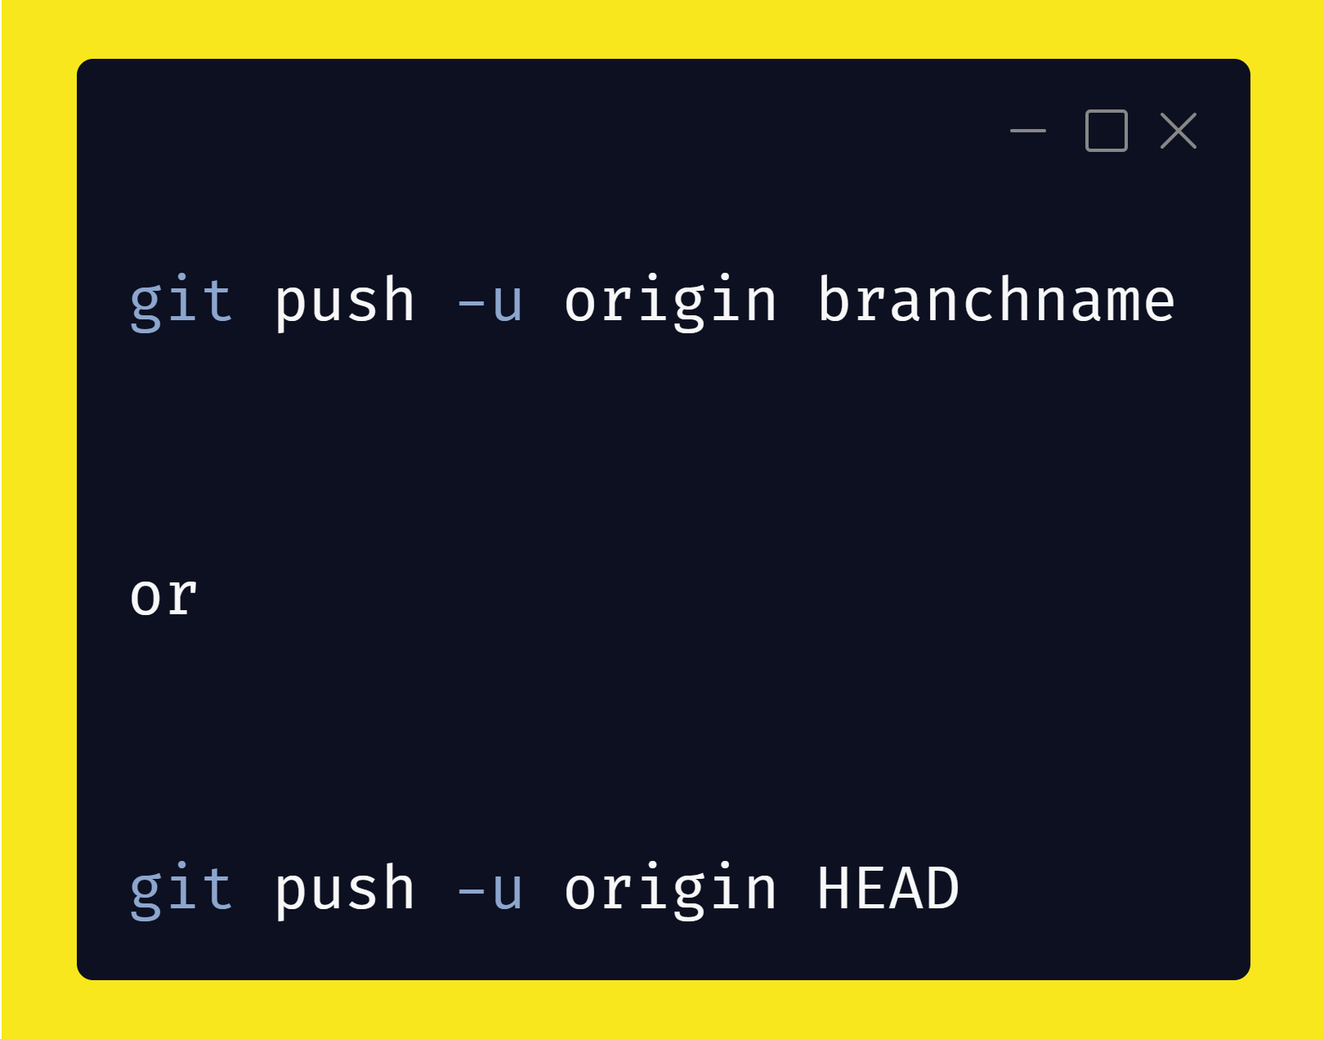
Push a branch

Slide 25
Other Git commands

Slide 26
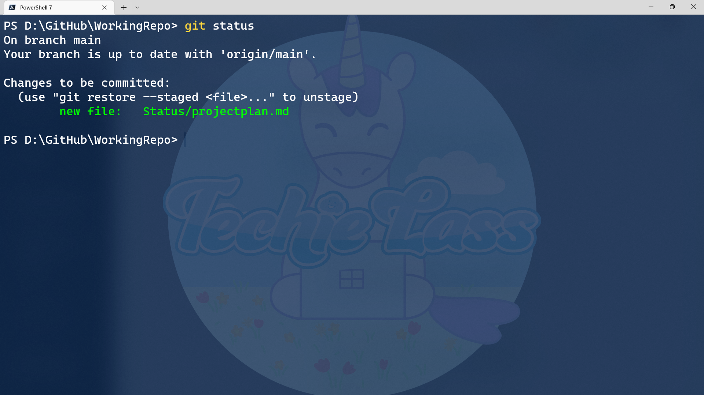
Git Status

Slide 27
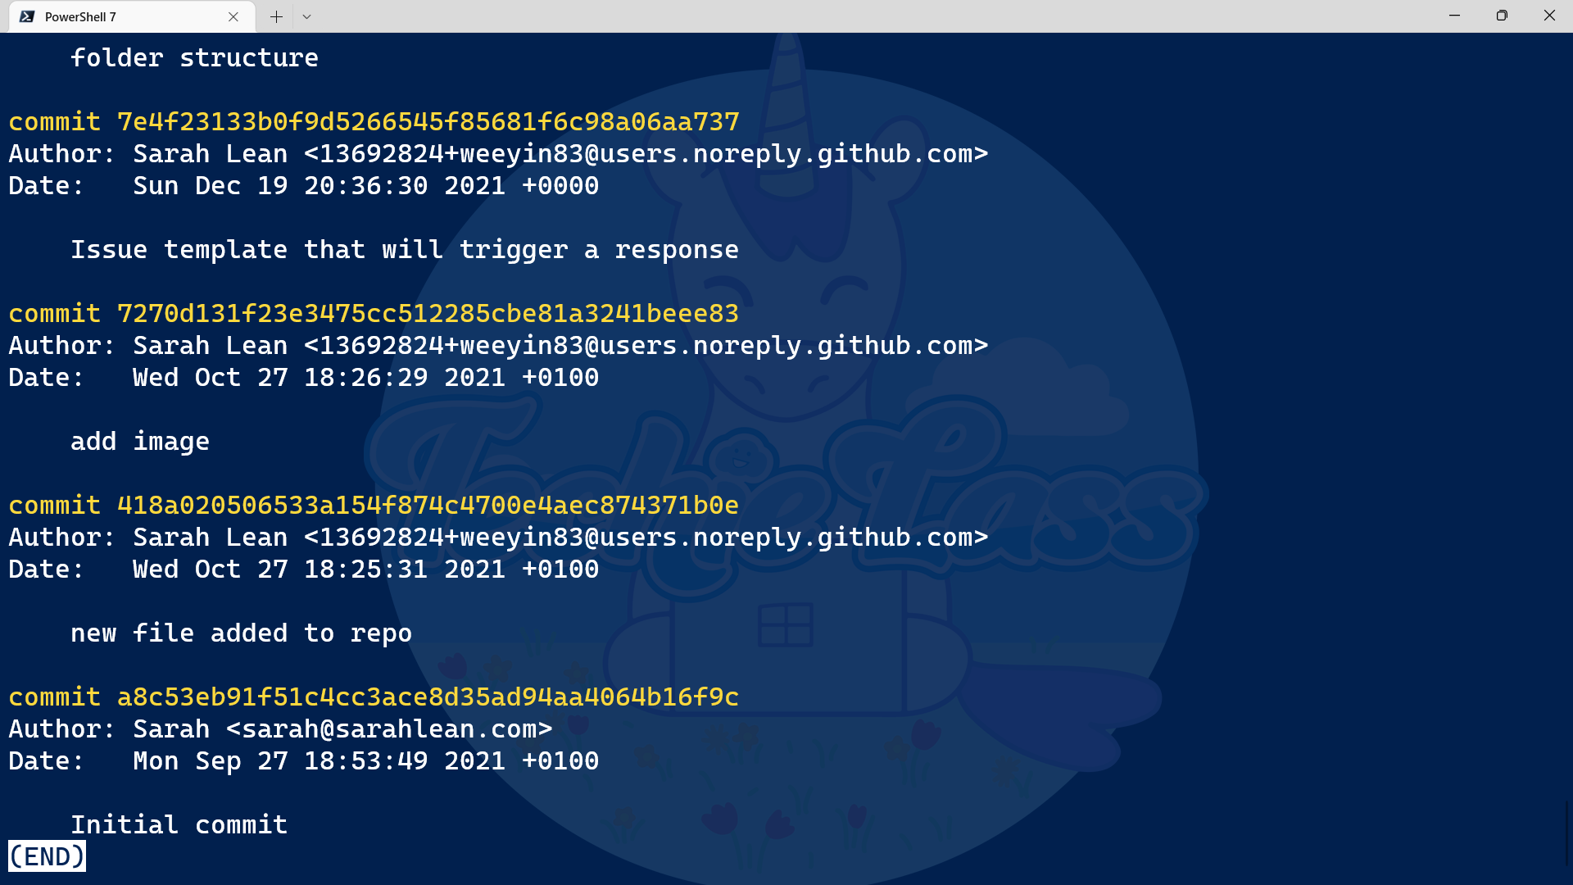
Git Log

Slide 28
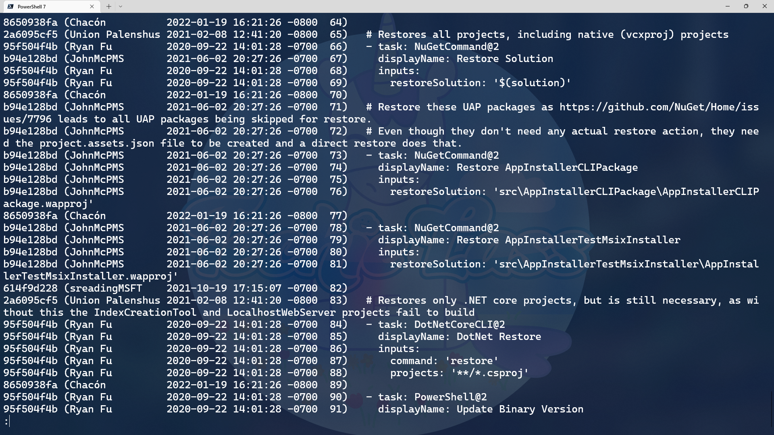
Git Blame

Slide 29
Even the most die-hard CLI user will be more productive with a web UI in certain situations due to fundamental strengths of GUIs that ultimately are tied to traits inherent in humans
Micah Linnemeier
UX designer at IBM

Slide 30
FREE GITKRAKEN ACCOUNT
https://bit.ly/sarah-gitkraken

Slide 31


Resources
Azure OpenAI Service – Advanced Language Models | Microsoft Azure
Speech to Text – Audio to Text Translation | Microsoft Azure
More information:
Keep the conversation going!
Sarah Lean
@Techielass
https://bit.ly/git-resources

